Slide 1
Instructor email :
nirosha.dinayadura@unt.edu

Slide 2
Chapter 1: Introduction

Slide 3
Learning Objectives
Understand what is a database
Define a database model
Explain the three layers of a database
Explain the functionality of each component of a database

Slide 4
Outline
Database-System Applications
Purpose of Database Systems
View of Data
Database Languages
Database Design
Database Engine
Database Architecture
Database Users and Administrators
History of Database Systems

Slide 5
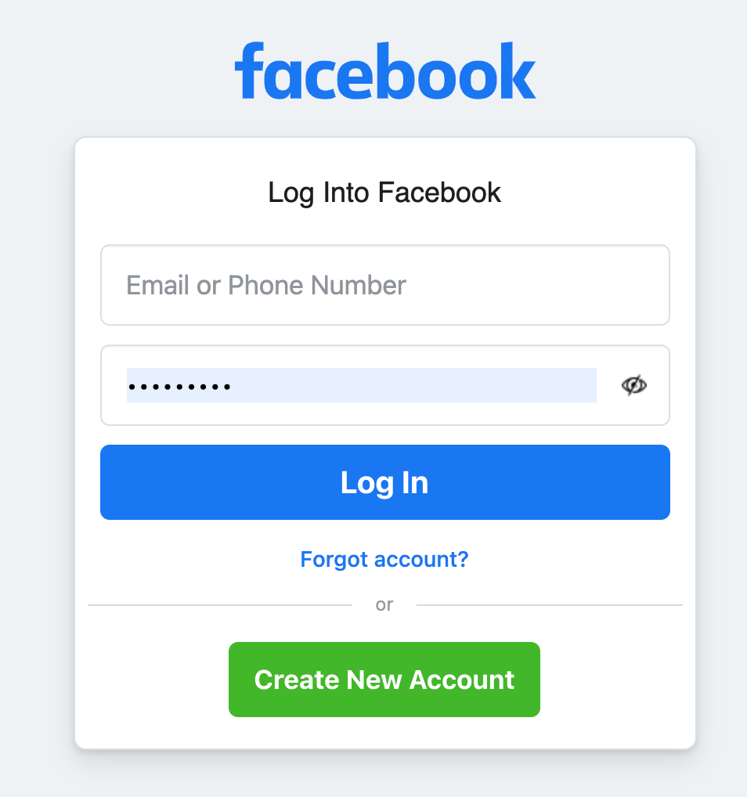
Facebook
How many users?
How do they know if it is you?
How do they determine which
information to display to you?
Notes:
With roughly 2.93 billion monthly active users as of the second quarter of 2022, Facebook is the most used online social network worldwide.

Slide 6

Amazon
How do we manage to control over buying?
There are 10 items left in the warehouse. 100 customers trying to add it to the cart
List of products, where do we keep them?

Slide 7
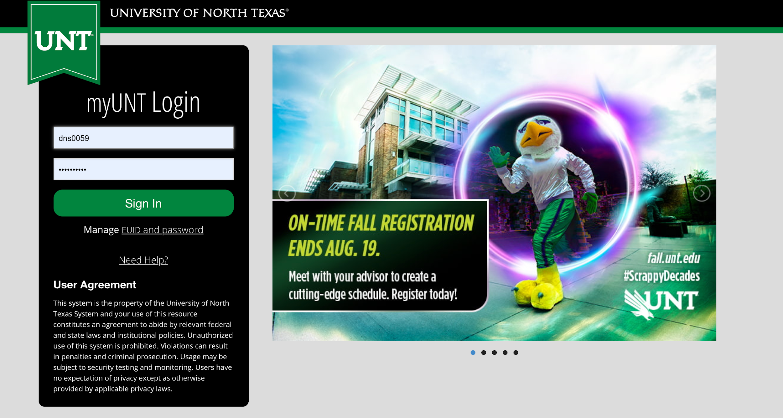
My.unt.edu
Look familiar, right?
What is happening here?
Can someone else see your results?

Slide 8
Front-end and back-end
Back-end
Front-end
Database
Back-end
server
Your username
and
password are here

Slide 9
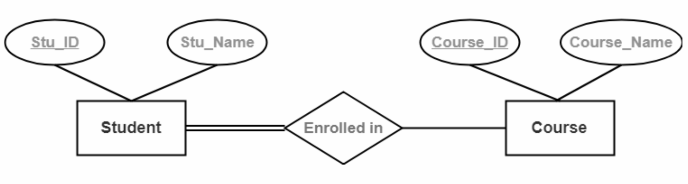
How many of you have seen something like this?
Street
Student
Address
City
Address
State
Notes:
Total participation

Slide 10
Database Systems
DBMS contains information about a particular enterprise
Collection of interrelated data
Set of programs to access the data
An environment that is both convenient and efficient to use
Database systems are used to manage collections of data that are:
Highly valuable
Relatively large
Accessed by multiple users and applications, often at the same time.
A modern database system is a complex software system whose task is to manage a large, complex collection of data.
Databases touch all aspects of our lives
Notes:
10
MySQL
MariaDB
Microsoft SQL Server
Oracle DBMS
PostgreSQL
MongoDB
Redis
IBM DB2
Elasticsearch
SQLite

Slide 11
Database Applications Examples
Enterprise Information
Sales: customers, products, purchases
Accounting: payments, receipts, assets
Human Resources: Information about employees, salaries, payroll taxes.
Manufacturing: management of production, inventory, orders, supply chain.
Banking and finance
customer information, accounts, loans, and banking transactions.
Credit card transactions
Finance: sales and purchases of financial instruments (e.g., stocks and bonds; storing real-time market data
Universities: registration, grades
Notes:
11

Slide 12
Database Applications Examples (Cont.)
Airlines: reservations, schedules
Telecommunication: records of calls, texts, and data usage, generating monthly bills, maintaining balances on prepaid calling cards
Web-based services
Online retailers: order tracking, customized recommendations
Online advertisements
Document databases
Navigation systems: For maintaining the locations of varies places of interest along with the exact routes of roads, train systems, buses, etc.
Notes:
12

Slide 13
Purpose of Database Systems
In the early days, database applications were built directly on top of file systems, which leads to:
Data redundancy and inconsistency: data is stored in multiple file formats resulting in duplication of information in different files
Difficulty in accessing data
Need to write a new program to carry out each new task
Data isolation
Multiple files and formats
Integrity problems
Integrity constraints (e.g., account balance > 0) become “buried” in program code rather than being stated explicitly
Hard to add new constraints or change existing ones
Notes:
13
A lower isolation level increases the ability of many users t o access the same data at the same time, but increases the number of concurrency effects
Data inconsistency means that different files may contain different information about a particular object or person.
If DBMS has reduced the data redundancy then the database system leads the better data consistency.
Our data items appear only once (no redundancy) so the updated values are immediately available to all users.

Slide 14
Purpose of Database Systems (Cont.)
Atomicity of updates
Failures may leave database in an inconsistent state with partial updates carried out
Example: Transfer of funds from one account to another should either complete or not happen at all
Concurrent access by multiple users
Concurrent access needed for performance
Uncontrolled concurrent accesses can lead to inconsistencies
Ex: Two people reading a balance (say 100) and updating it by withdrawing money (say 50 each) at the same time
Security problems
Hard to provide user access to some, but not all, data
Database systems offer solutions to all the above problems
Notes:
14

Slide 15
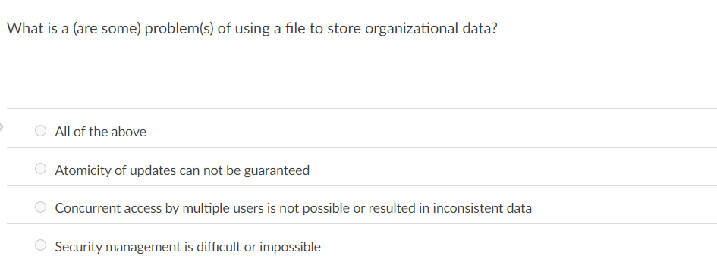

Slide 16
Data Models
A collection of tools for describing
Data
Data relationships
Data semantics
Data constraints
Relational model
Entity-Relationship data model (mainly for database design)
Object-based data models (Object-oriented and Object-relational)
Semi-structured data model (XML)
Other older models:
Network model
Hierarchical model
Notes:
16

Slide 17
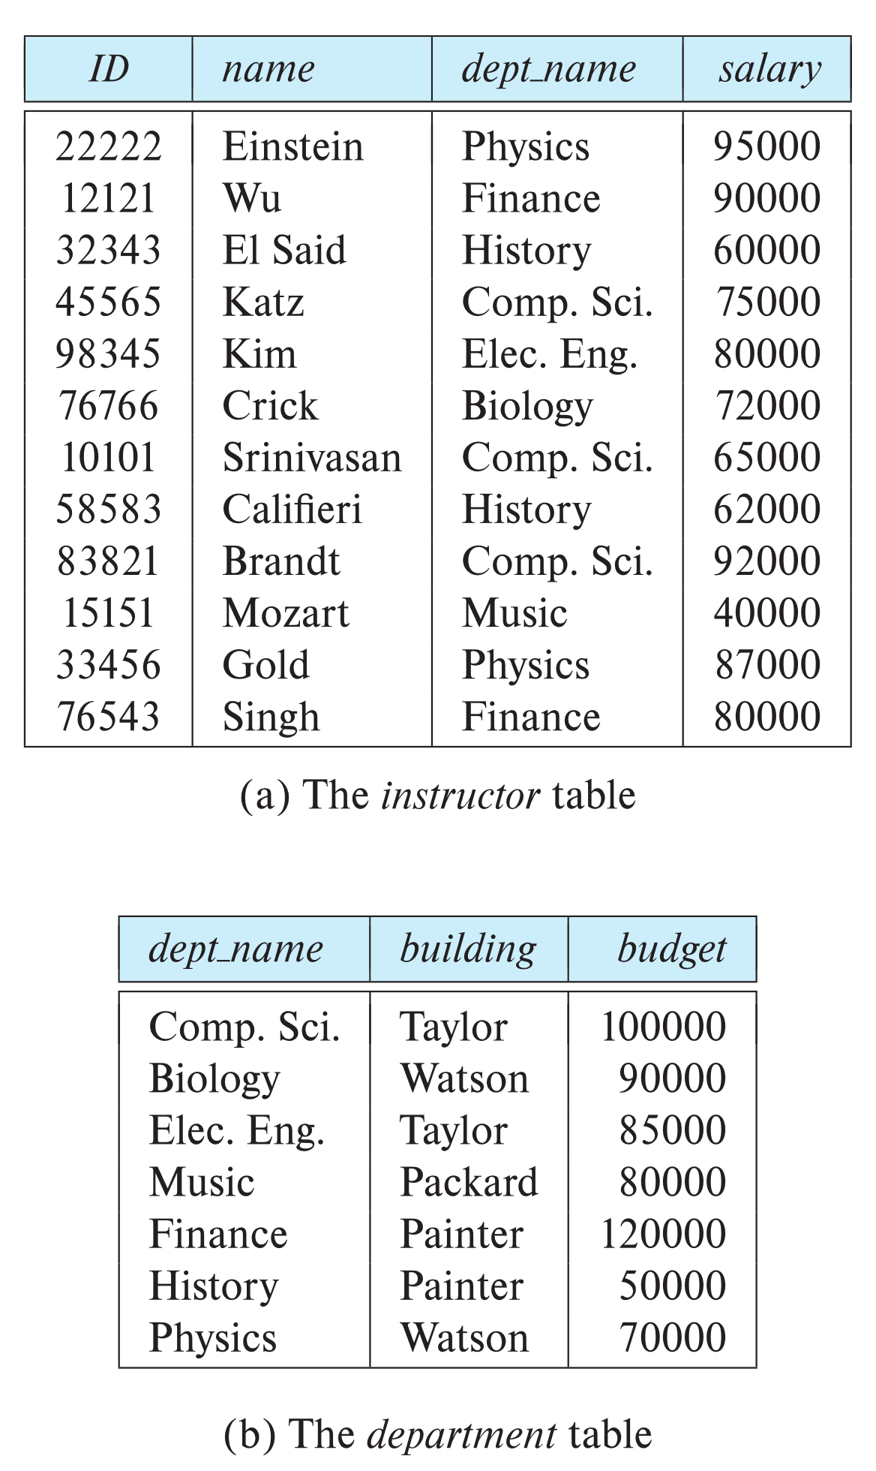

Relational Model
All the data is stored in various tables.
Example of tabular data in the relational model
Columns
Rows
Ted Codd Turing Award 1981
Notes:
17

Slide 18
A Sample Relational Database
Notes:
18

Slide 19
Levels of Abstraction
Physical level: describes how a record (e.g., instructor) is stored. Location,size,blocks of storage,which file,memory used
Logical level: describes what data stored in database, and the relationships among the data.-how data is represented in table format.
type instructor = record
ID : string; name : string; dept_name : string; salary : integer;
end;
View level: application programs hide details of data types. Views can also hide information (such as an employee’s salary) for security purposes.
Definition : database systems are made up of complex data structures.to ease user interaction with database the developers hide internal irrelevant detsils from the users. The process of hiding this irrelevant data from the users is called data abstraction
Notes:
19
Retrieve data efficiently-need complexdata structures to represent data in database, so developers hide complexity from users through several layes of abstraction to simplify users interaction with the system.
Physical level- how data are actualy stored. Describes complex low level data structures in details.
Logical level describes the entire database in terms of a small number of relatively simple structures. Although imp;lamentation of the simple structutures at the logical level may involve complex physical level strucutes, the user of the logical level does not need to aware of this complexity. This referred to as physical data independence . Level
type instructor = record
ID : string; name : string; dept_name : string; salary : integer;
end;
This code defines a new record type called instructor with 4 fields. Each field has a name and a type associated with it. For example, char 20 specifies a string with 20 characters. Numeric (8,2) specifies a number with 8 digits. Two of which are to the right of the decimal point.
Interrelationship of these record types is also defined at the logical level. Ex: a requirement that the dept_name value of an instructor record must be appear in the dept. table.=programmers
View level- computer users-see a set of application programs that hide details of the data types. Several vievs-users see some of vievs
Y views
Hide details of logical level
Security mechanism to prevent users from accessing certain parts of the database. Ex: clerks of registar office can see student info but not instructor salaries.
layers of db
When we loggin in to gmail using our credentials, we do not know which location our data are stored and how data are stored.
But we see our data are well organized in a graphical user interface and other details are not shown to us. This is called the data abstraction.
Definition : database systems are made up of complex data structures.to ease user interation with database the developes hide internal irrelevant detsils from the users. The process of hiding this irrelevant data from the users is called data abstraction
This is the level data is actually present. –we know data is is stored in which file. Size of the file. Blocks of storage. Memory used. Location of data storage (which server or hard disk)
(designing of the database-Data base administrators work)
Logical level has more abstraction than physical level. We use er models in this levels entites and attributes and relations between entities,. Data is actualy stored in files but how it is represented. It represented in table format.(conceptual level).-programmers work in this level.
View level=how data is shown to the end user.higher level of abstraction. Many different views for a database.
Ltes consider unt database. Students see their personal details, course details.
Instucture will see studnetns grades
According to the user it decide which data must be hidden and wich to show. This is the user interaction level with database.

Slide 20
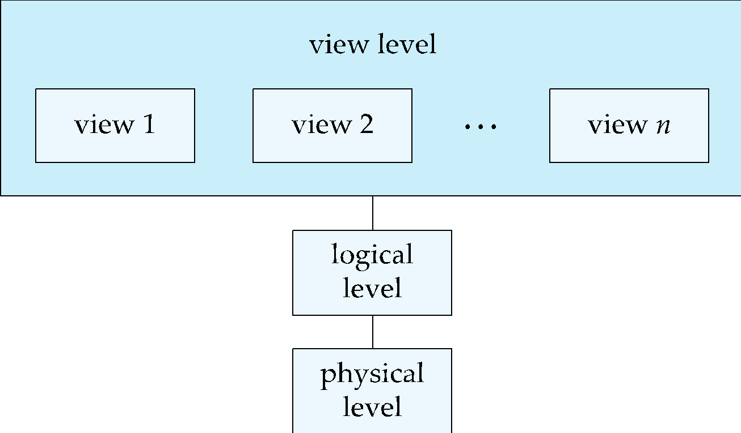
View of Data
An architecture for a database system
Notes:
20

Slide 21
Instances and Schemas
Similar to types and variables in programming languages
Overall design of the database - Schema
Logical Schema – the overall logical structure of the database
Example: The database consists of information about a set of customers and accounts in a bank and the relationship between them
Analogous to type information of a variable in a program- variable declaration
Physical schema – the overall physical structure of the database
Instance – the actual content of the database at a particular point in time
Analogous to the value of a variable
A database may also have several schemas at the view level-subschemas.
Notes:
21
Concept of schema and instance – program written in programming language
Db schema – corresponds to a variable declarations(along with associated type definition) in a program
Each variable has a particular at a given instance- instance.
According to the level of abstraction – physical schema, logical schema
Physica= database design at physical level
A database may also have several schemas at the view level-subschemas.

Slide 22
Physical Data Independence
Physical Data Independence – the ability to modify the physical schema without changing the logical schema – Ex:data stored as array or linked list
Applications depend on the logical schema
In general, the interfaces between the various levels and components should be well defined so that changes in some parts do not seriously influence others.
Notes:
22
Eg- data stored as array or linked list
Seqencial file system or hash file

Slide 23
Data Definition Language (DDL)
Specification notation for defining the database schema
Example: create table instructor ( ID char(5), name varchar(20), dept_name varchar(20), salary numeric(8,2))
DDL compiler generates a set of table templates stored in a data dictionary
Data dictionary contains metadata (i.e., data about data)
Database schema
Integrity constraints – domain constrain and referential integrity
Primary key (ID uniquely identifies instructors)
Authorization
Who can access what
Notes:
23
to define logical schema u need a language
Integrity constraints
1.Domain constrain- attrib values-int types….
2.Referential integrity
data dictionary-special type of table can be accessed and updated db system itself.
Executing this table will create instructor table with 4 columns with different data types.
Intrgrity constrains – specify id as primary key. Foreign key.

Slide 24
Data Manipulation Language (DML)
Language for accessing and updating the data organized by the appropriate data model
DML also known as query language
There are basically two types of data-manipulation language
Procedural DML -- require a user to specify what data are needed and how to get those data.
Declarative DML -- require a user to specify what data are needed without specifying how to get those data.
Declarative DMLs are usually easier to learn and use than are procedural DMLs.
Declarative DMLs are also referred to as non-procedural DMLs
The portion of a DML that involves information retrieval is called a query language.
Notes:
24
Retrieve, insert ,delete,modify

Slide 25
SQL Query Language
SQL query language is nonprocedural. A query takes as input several tables (possibly only one) and always returns a single table.
Example to find all instructors in Comp. Sci. dept
select name from instructor where dept_name = 'Comp. Sci.'
To be able to compute complex functions SQL is usually embedded in some higher-level language
Application programs generally access databases through one of
Language extensions to allow embedded SQL
Application program interface (e.g., ODBC/JDBC) which allow SQL queries to be sent to a database
Declarative DML -- require a user to specify what data are needed without specifying how to get those data.
Notes:
25
Most widely used query language is SQL.
Query processor translates dml queries in to sequence of actions at the physical level.
Input several tb and op 1 table. Here is a example of an query find name of all instructors in comp. dept.
Retrieve records of table instructor – display names
There are some computations that are possible using a general purpose programming lang. but not possible using SQL. Sql does not support actions such as input from users, output to displays and communication over network. Possible with c/c+ java, or python with embedded sql queries that access the data in thedatabase.
Application programs are programs that used to interact with database in this fashion. Examples in university system are programs that allow students to register for courses,generate class rosters, calculate student GPA. Generate payroll checks
To access the database, DML statements need to be sent from the host to the db where they will be executed. This is most commomly done by using an application-program interface (set of procedures) that can be used to send DML and DDL stts to the database and retrieve the results. The open database connectivity standard defines application program interfaces for for users with C and several other languages. The java database connectivity defines corresponding interface for java language.

Slide 27
Database Design
The process of designing the general structure of the database:
Logical Design – Deciding on the database schema. Database design requires that we find a “good” collection of relation schemas.
Business decision – What attributes should we record in the database?
Computer Science decision – What relation schemas should we have and how should the attributes be distributed among the various relation schemas?(how to group attributes to form tables)
(describing data and relationships) (ER and normalization)
Physical Design – Deciding on the physical layout of the database
(form of file organization and the internal storage structures)
Notes:
27
The process of moving from an abstract data model to the implementation of the db proceeds in to 2 final design phases. In the logical design phase, the designer maps the high-level conceptual schema in to the implementation data model of the db system that will be used. The designer uses the resulting system specificdb schema in the physical-design phase,in which the physical featuresof the db are specified. Includes the form of file organization and the internal storage structures.
The designer uses the resulting system specific db schema
Db design mainly involves the design of the db schema. Do not talk here application desig. –design of a complete db application environment
Here db queries and design of db schema- later application design
A high level data model provides the db designer with a conceptual framework in which to specify the data requirements of the db users and how the db will be structured to full filthese requirements. The initial phase od db design, then is to characterized fully the data need of db users. So db designer intract with domain experts and users. Op 1. specification of requirements.
2. Db designer Choose data model and by applying the concepts of db model , translate requirements in to a conceptual schema of db. It gives a detail overview of the enterprice. At this stage designer can review the schema to ensure it meets functional requirements.

Slide 28
Database Engine
A database system is partitioned into modules that deal with each of the responsibilities of the overall system.
The functional components of a database system can be divided into
The storage manager, - giga to tera bytes-disk storage -ssd
The query processor component, -facilitate data access
The transaction management component.
Notes:
28
Storage manager is important because db require large amount of storage.-db n size hundred of gb to tera bytes (1 million gb) of data. Large enterprice data peta bytes of data. Stored in disks(not in main memory-system crash mem loss) data moved between main mem and disk as needed . Movement is slow. Db sys structure data to minimize data movement. Now ssd are used to db storage.
Q processor- helps db system tosymplify and facilitate access of data. It allow db users to obtain good performance while being able towork at the view level hide physical-level details.
T manager-allows app developers to treat a seence of db accesses as if they were a sigle unit that either happens in entirely or not at all.
Db engines traditionaly centralized computer systems. Today parall processing

Slide 29
Storage Manager
A program module that provides the interface between the low-level data stored in the database and the application programs and queries submitted to the system.
The storage manager is responsible to the following tasks:
Interaction with the OS file manager
Efficient storing, retrieving and updating of data
The storage manager components include:
Authorization and integrity manager- checks for integrity constrains-checks for authority to access data
Transaction manager –ensure consistency of db, concurrent transaction with out conflicts
File manager- manages allocation of space on disk and data strucures
Buffer manager -fetching data from disk to memory and deciding what data to cache.
Notes:
29
Row data are stored on the disk using the file system provided by os. St mr translate dml stts in to low-level file-sys commands.-store retrieve update data in db.
Includes-

Slide 30
Storage Manager (Cont.)
The storage manager implements several data structures as part of the physical system implementation:
Data files -- store the database itself
Data dictionary -- stores metadata about the structure of the database, in particular the schema of the database.
Indices -- can provide fast access to data items. A database index provides pointers to those data items that hold a particular value.
Notes:
30
where to save and how to save

Slide 31
Query Processor
facilitate data access
The query processor components include:
DDL interpreter -- interprets DDL statements and records the definitions in the data dictionary.
DML compiler -- translates DML statements in a query language into an evaluation plan consisting of low-level instructions that the query evaluation engine understands.
The DML compiler performs query optimization; that is, it picks the lowest cost evaluation plan from among the various alternatives.
Query evaluation engine -- executes low-level instructions generated by the DML compiler.
Notes:
31

Slide 32
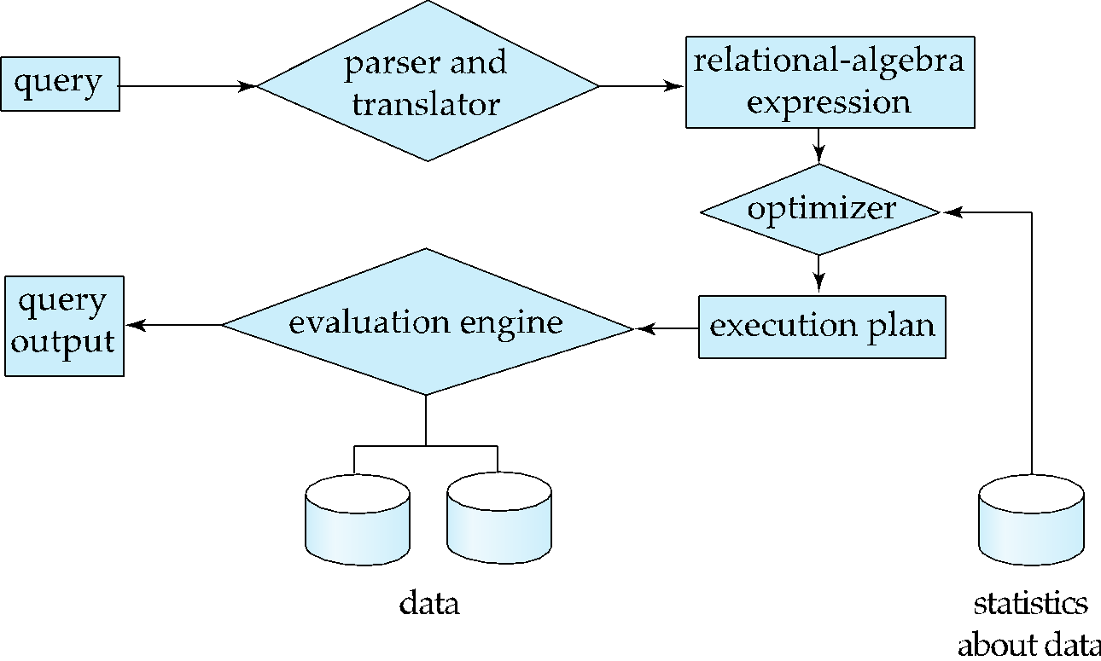
Query Processing
1. Parsing and translation
2. Optimization
3. Evaluation
Notes:
32

Slide 33
Transaction Management
A transaction is a collection of operations that performs a single logical function in a database application
Transaction-management component ensures that the database remains in a consistent (correct) state despite system failures (e.g., power failures and operating system crashes) and transaction failures.
Concurrency-control manager controls the interaction among the concurrent transactions, to ensure the consistency of the database.
(transactions updates the database concurrently)
Notes:
33
Fund transfer between account a nd b. both occour or not occur at all.-atomicity.
Several transactions updates the db concurrently, consistency –cc manager responsibility
Cc in financial applications.

Slide 34
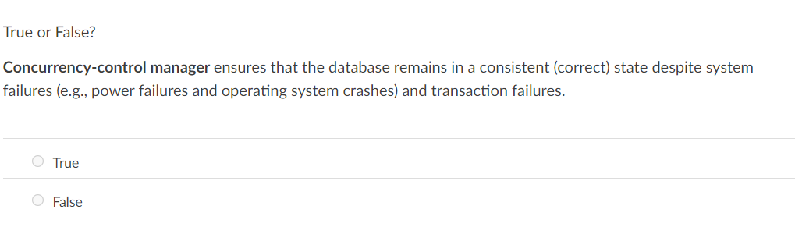

Slide 35
Database Architecture
Centralized databases
One to a few cores, shared memory –DB and the sever is in same machine
Client-server,
One server machine executes work on behalf of multiple client machines.
Parallel databases
Many core shared memory
Shared disk
Shared nothing
Distributed databases
Geographical distribution
Schema/data heterogeneity
Notes:
35
Architecture of db sys run on centralized server machine.
Client,server and db all in same machine.

Slide 36
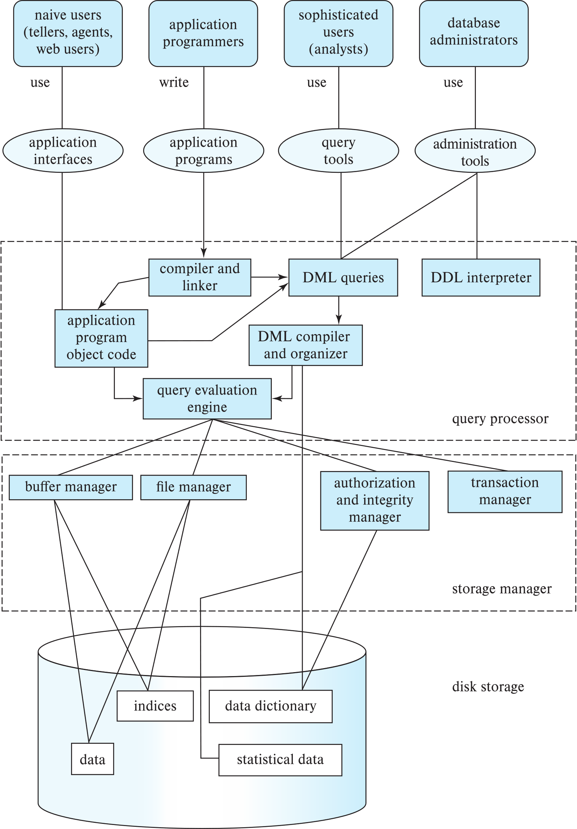
Database Architecture (Centralized/Shared-Memory)
how different components of a db engines are connected to each other.
Notes:
Architecture of db sys run on centralized server machine.
Figure summarize how different type of users (naïve users,app programmers,analysists,ad admin)interact with a db and how different components of a db engines are connected to each other.
Shared memory server architecture-multiple cpu and exploit parallel processing-all cup access common shared memory)

Slide 37
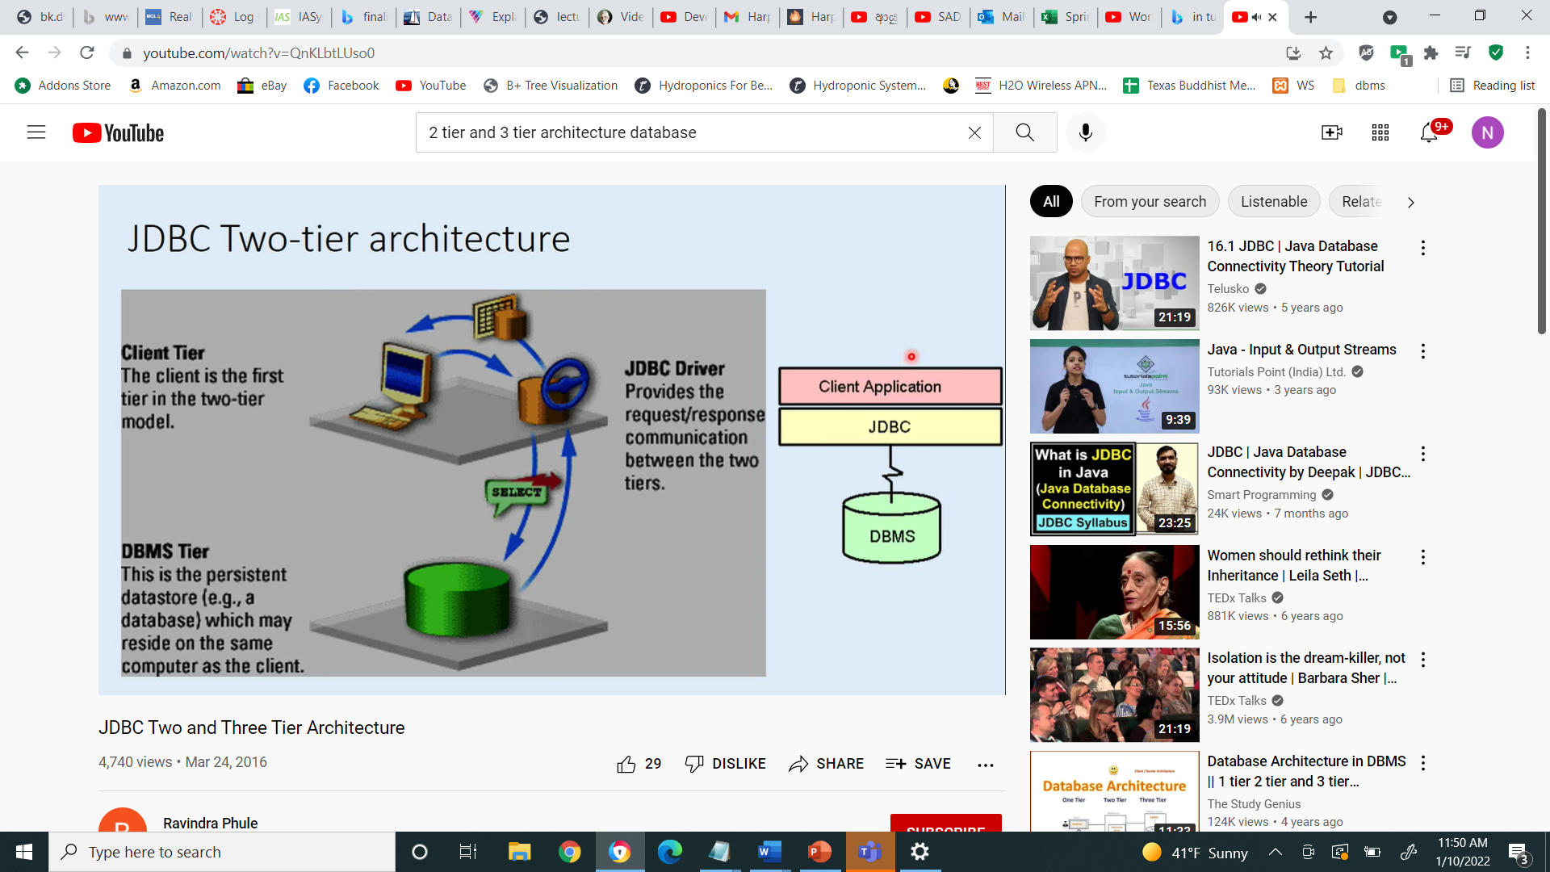
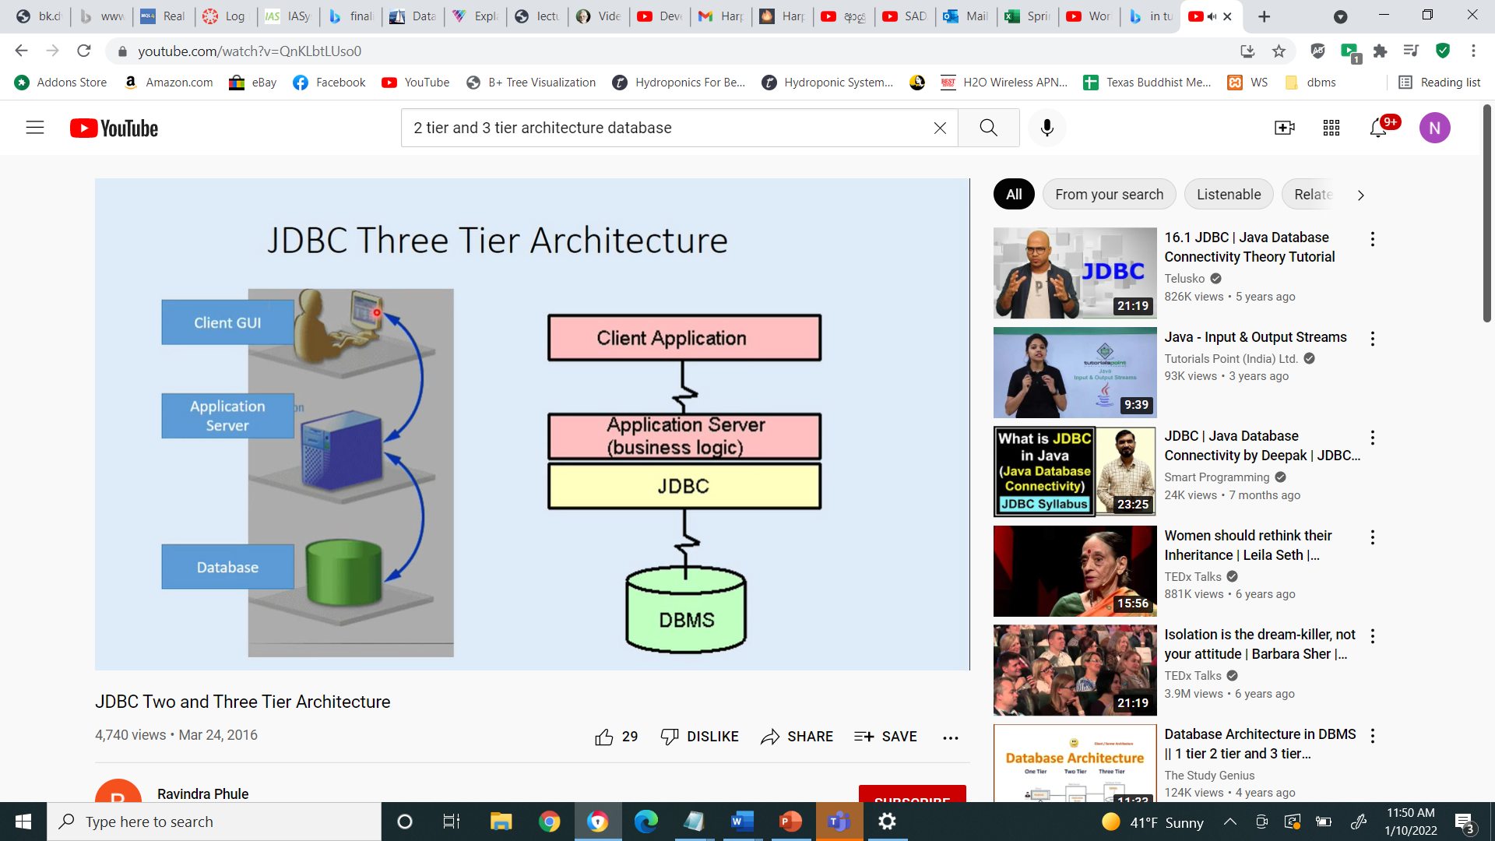
Database Applications
Database applications are usually partitioned into two or three parts
Two-tier architecture -- the application resides at the client machine, where it invokes database system functionality at the server machine
Three-tier architecture -- the client machine acts as a front end and does not contain any direct database calls.
The client end communicates with an application server, usually through a forms interface.
The application server in turn communicates with a database system to access data.
architecture of applications
Notes:
37
We now consider the architecture of applications that use databases as back end. Db applications can be partitioned in to 2 or 3 parts
Early generation db app uses – 2 tire arch- app resides at the client machine, and invokes db system functionality at the server machine through query language stts.
Modern db app uses 3 tire architecture – client machine acts as merely a front end and does not contain any direct db calles. Web browsers and mobile applications are the most commonly used application clients today. The front end communicates with an application server. The application server, in turn, communicate with a db system to access data. The business logic of the application,which says what actions to carry out under what condition, is embedded in the application server, instead of being distributed across multiple clients. – better security,better performance.

Slide 38
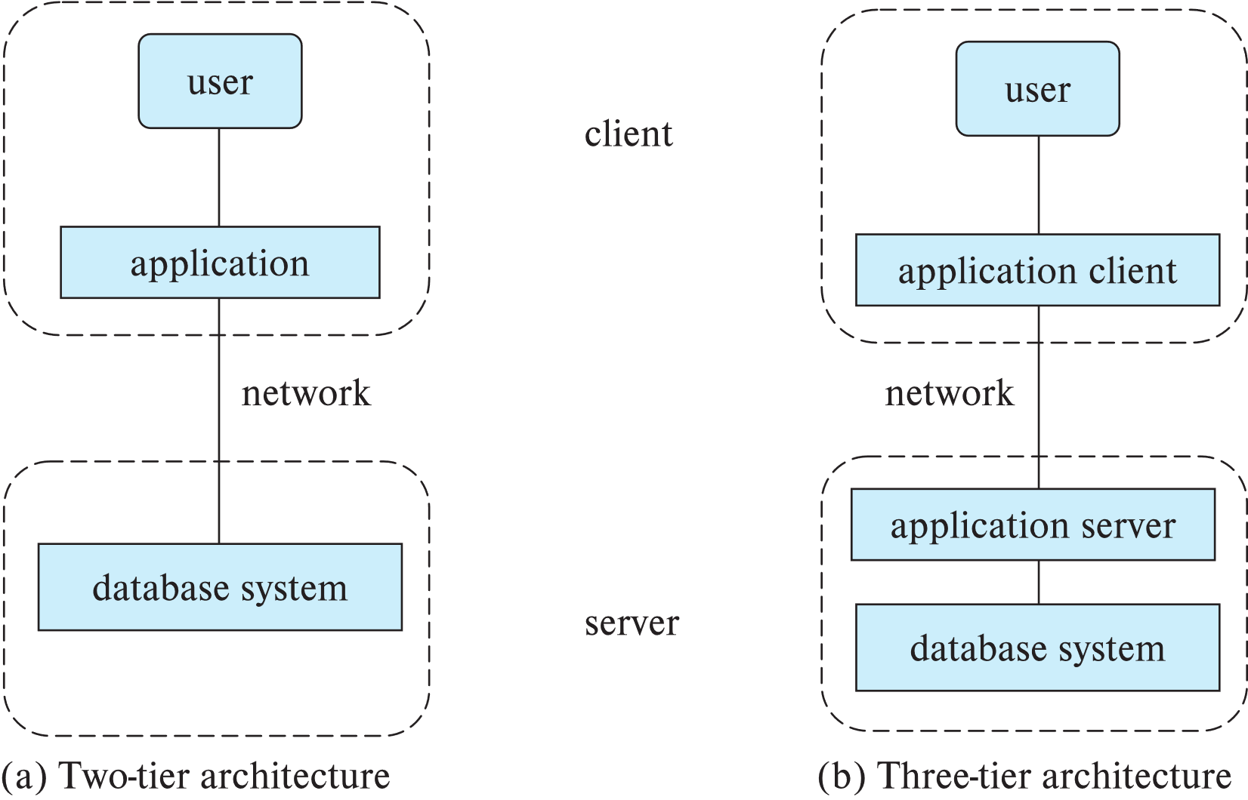
Two-tier and three-tier architectures
Notes:
38
Application client – web browsers and mobile applications –front end .

Slide 39

Database Users
Notes:
39
Goal of db system is to retriev and store information in db, 2 groups work here users and admin.
Naïve users-interact with system using predefined user interface.-web and mobile application.-users can fill appropriate fields the form. – view and read reports generated from the db.
Class registration. Register for class using a web interface. User connects to a web app program runs at web server. App first verify the identity of the user and then allow her to access a form where she enters info. Form info is send back to web application at yhe server,which then determines if there is room in the class(by retrieving info from the db)if so add student info to the class roaster in db.
Progrmmer- write app program
Sop user- interact with system with out writing the program. They request using db query language by using data analysis sw.

Slide 40
Database Administrator
A person who has central control over the system is called a database administrator (DBA). Functions of a DBA include:
Schema definition
Storage structure and access-method definition
Schema and physical-organization modification
Granting of authorization for data access
Routine maintenance
Periodically backing up the database
Ensuring that enough free disk space is available for normal operations, and upgrading disk space as required
Monitoring jobs running on the database
Notes:
40
One of main reason for using dbms is to have central control of both data and the programs ahat access data. The person who has such control is dba.
1. By execution a set of DDL statements.,
2, specify some parameters pertaining to the physical organization of data and indices to be created.
3.Change need of the organization or to alter physical organization to improve performance.
4- by granting types of authorization dba can regulate which part of db various users can access.
5- Periodically backing up the database on to remote server to prevent loss of data in case of disasters flooding .
6-
7-Monitoring jobs running on the database and ensure that performance is not degraded by very expensive tasks submitted by some users.

Slide 41
History of Database Systems
1950s and early 1960s:
Data processing using magnetic tapes for storage
Tapes provided only sequential access
Punched cards for input
Late 1960s and 1970s:
Hard disks allowed direct access to data
Network and hierarchical data models in widespread use
Ted Codd defines the relational data model
Would win the ACM Turing Award for this work
IBM Research begins System R prototype
UC Berkeley (Michael Stonebraker) begins Ingres prototype
Oracle releases first commercial relational database
High-performance (for the era) transaction processing
Notes:
41

Slide 42
History of Database Systems (Cont.)
1980s:
Research relational prototypes evolve into commercial systems
SQL becomes industrial standard
Parallel and distributed database systems
Wisconsin, IBM, Teradata
Object-oriented database systems
1990s:
Large decision support and data-mining applications
Large multi-terabyte data warehouses
Emergence of Web commerce
Notes:
42

Slide 43
History of Database Systems (Cont.)
2000s
Big data storage systems
Google BigTable, Yahoo PNuts, Amazon,
“NoSQL” systems.
Big data analysis: beyond SQL
Map reduce and friends
2010s
SQL reloaded
SQL front end to Map Reduce systems
Massively parallel database systems
Multi-core main-memory databases
Notes:
43

Slide 44
Summery
Notes:
What is a DBMS and Advantages of using a DBMS

Slide 45
End of Chapter 1
Notes:
45

Slide 46
nirosha.dinayadura@unt.edu

Slide 48
Voice Level
0- Silent voice /No talking
1- Wisper voice/Partner talk
2-Normal voice/Table talk
3-Loud proud voice/Classroom talk

Slide 49
CSCE 5350 FDB

Slide 50
Instructor details
Instructor : Dr. Nirosha Dinayadura
Instructor email : nirosha.dinayadura@unt.edu
Instructor office hours : Friday 3-4 PM (Zoom) by appointment.
Instructor Zoom : https://unt.zoom.us/j/9643878225?pwd=SW1oSm5HUDh4OW5ZaVE5SnRHbW15Zz09
Meeting ID: 964 387 8225 Passcode: 5000

Slide 51
Grades
90% and above A
80% and above B
65% and above C

Slide 52
Grading criteria
Assignments (2) – 20%
Attendance –No Marks
Midterm examination I - 20%
Midterm examination II - 20%
Quizzes (4) – 20%
Project – 20%

Slide 53
Policy
1. Students must maintain a consistent attendance. If a student is absent for more than 3 classes he/she may be dropped from the class.
2. There will be no make-up exams unless there is a university-approved excuse.
3. Cheating is seriously considered and will be resulted in a dismissal from the class with a failure grade.
4. I will not respond to grading question by email. You must contact your graders regarding your concerns.
5. You can report to me if there is any concern with graders/TAs.
All the slides that will be used in this class will come from the textbook of this class.

Slide 54
Attendance
Be in class by 5.30 pm
All UNT rules and regulations should be followed.

Slide 55
Project Groups
Maximum 7 students per group.

Slide 56
TA/Grader Office hours

Slide 57

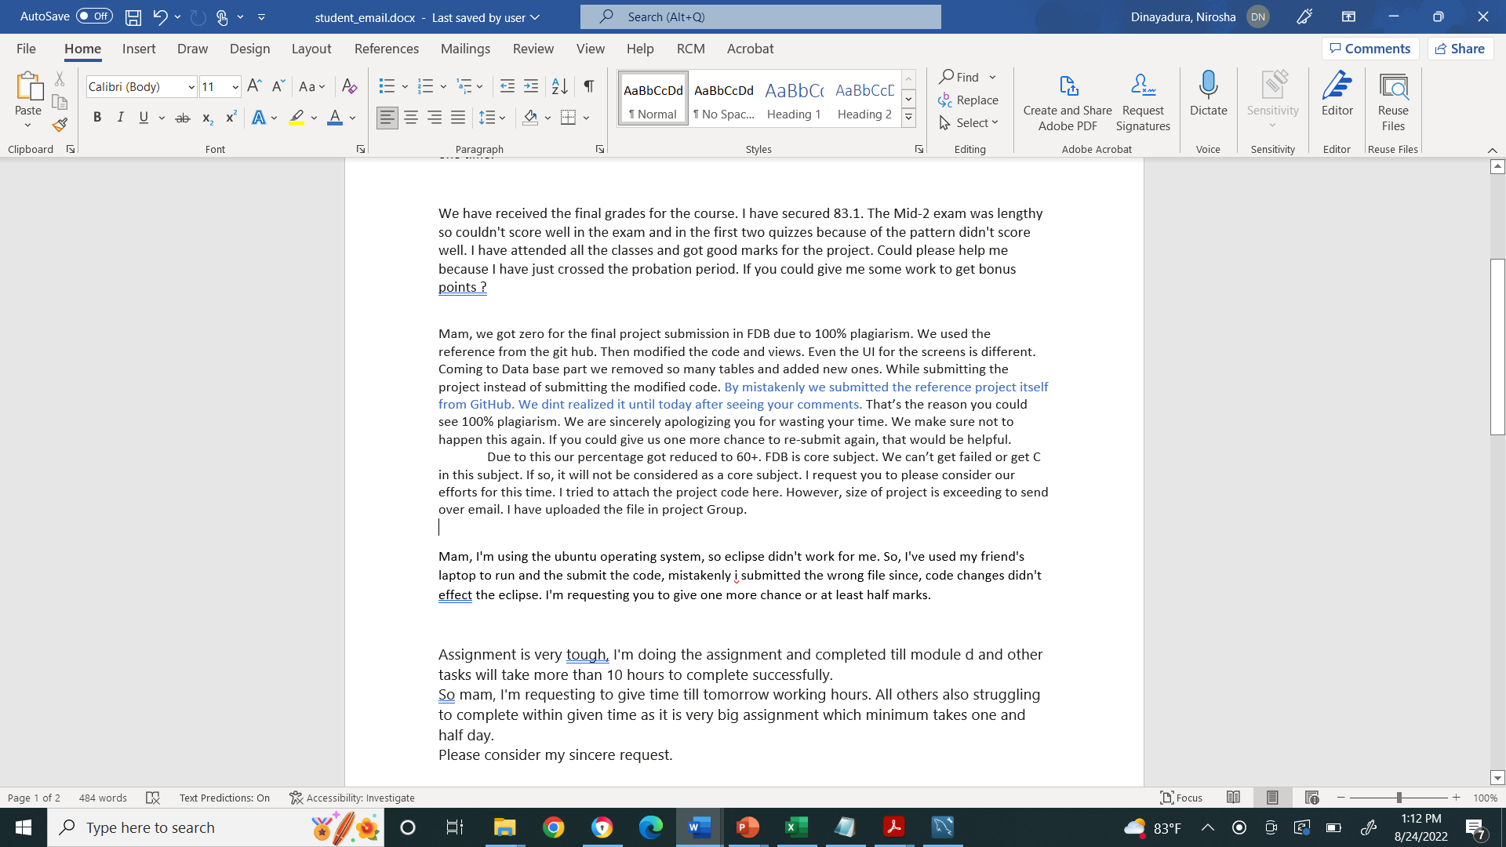
Email issues

Slide 58
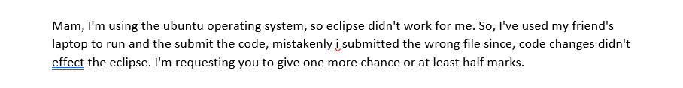

Slide 59
TA/IA positions
If students asks you for TA/IA positions, ask them to apply online whenever the positions are open and that the department will make the hiring decision.

